Slide 1
April 2021 Financial/May 2021 Enrollment Report
Board Meeting – May 26, 2021

Slide 2
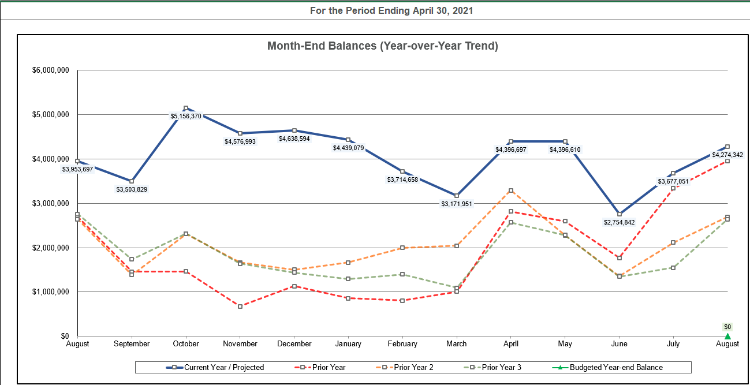
Month-End Fund Balances – Actual and Projected (through 8/31/21)

Slide 3
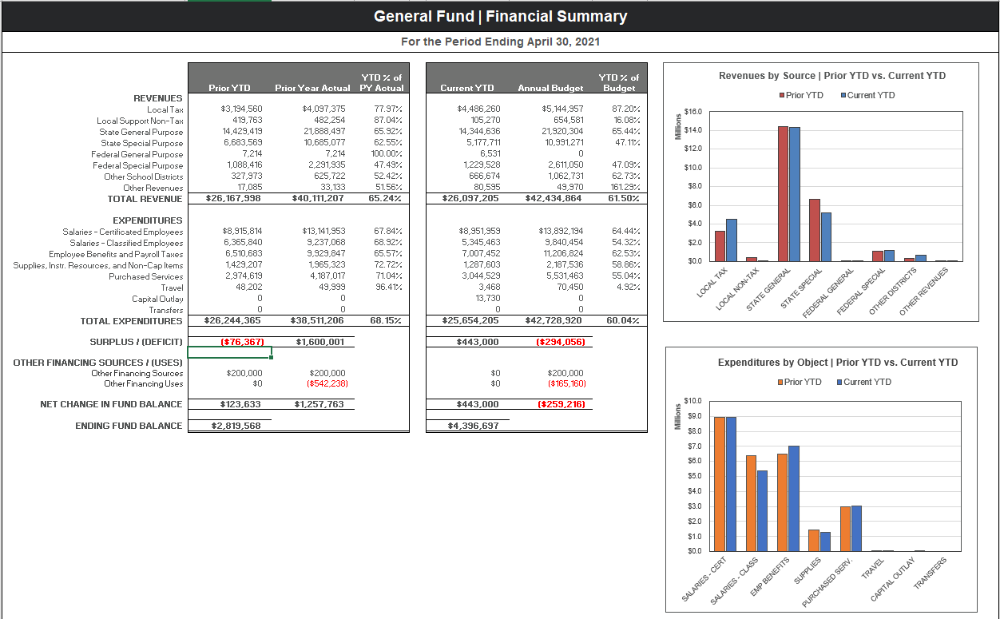
General Fund – Prior YTD and Current YTD Comparison

Slide 4
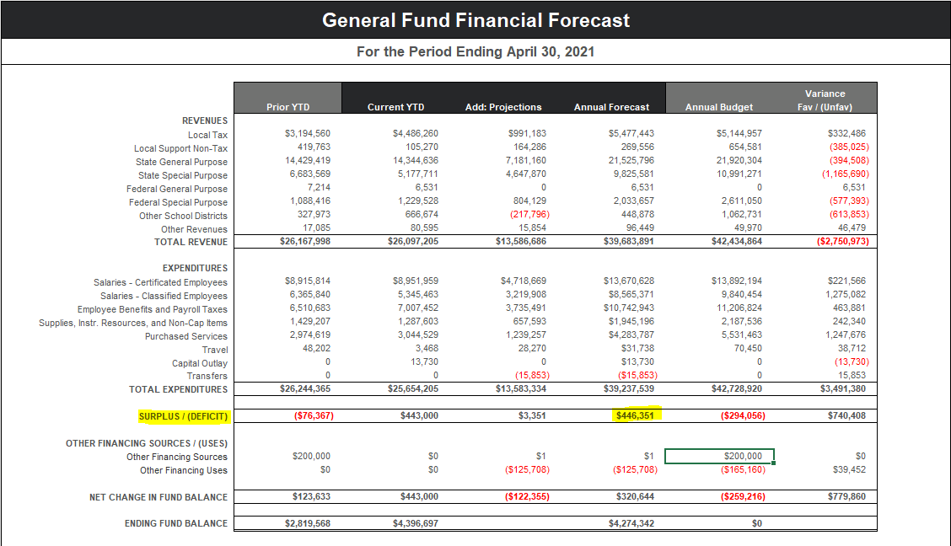
Financial Forecast – Actual thru 4/30/21 and Projections thru 8/31/21

Slide 5
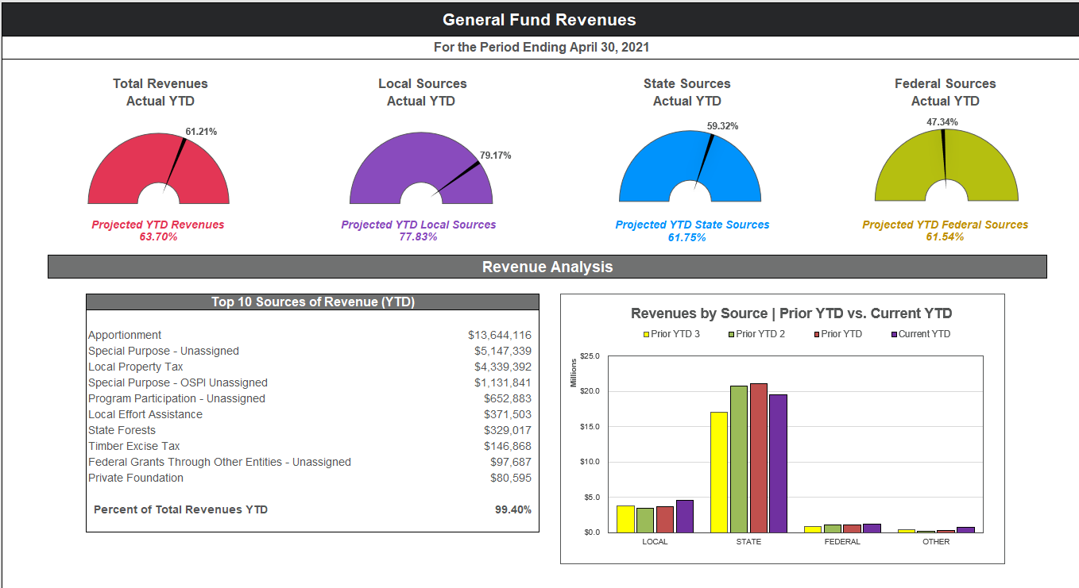
General Fund Revenue Summary

Slide 6
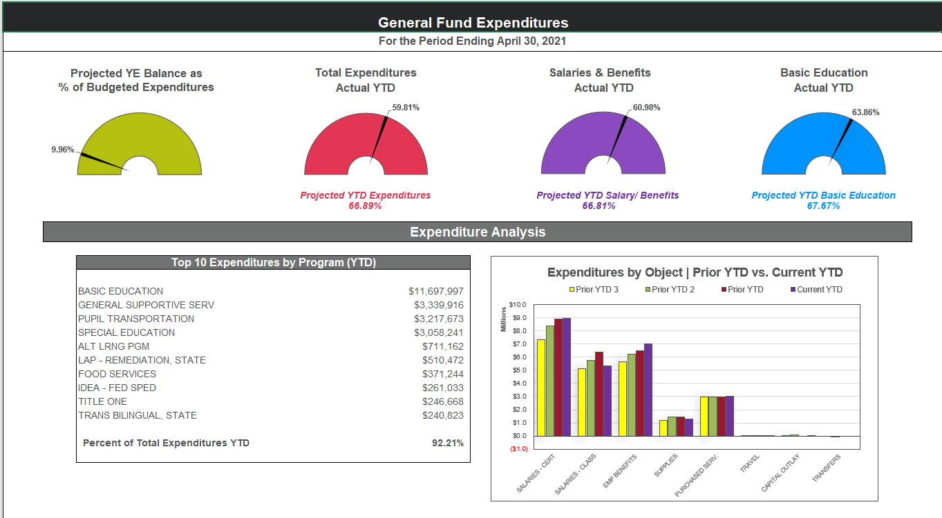
General Fund Expenditure Summary

Slide 7
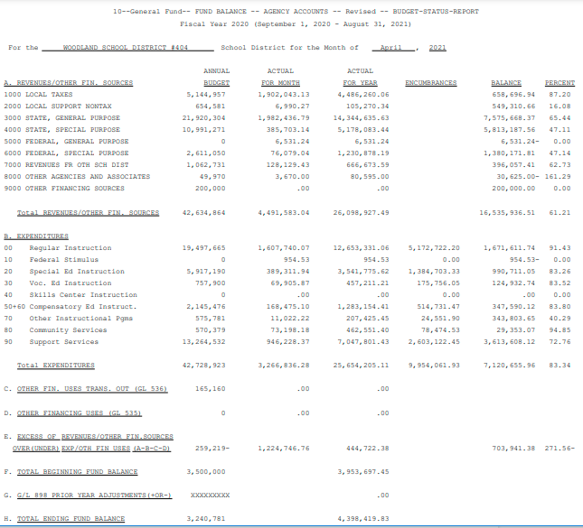
April 2021 Budget Status Report – General Fund

Slide 8
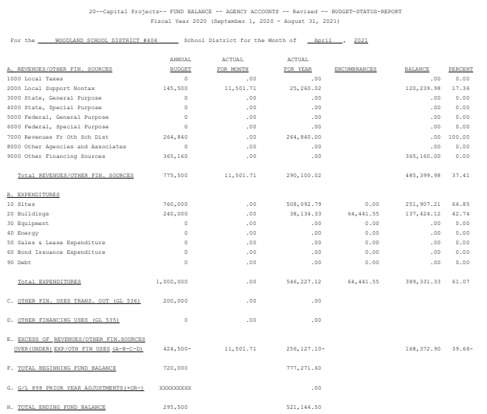
April 2021 Budget Status Report – Capital Projects Fund

Slide 9
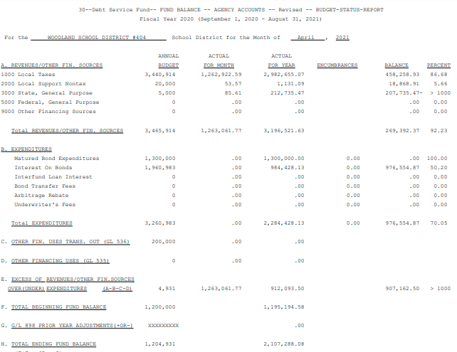
April 2021 Budget Status Report – Debt Service Fund

Slide 10
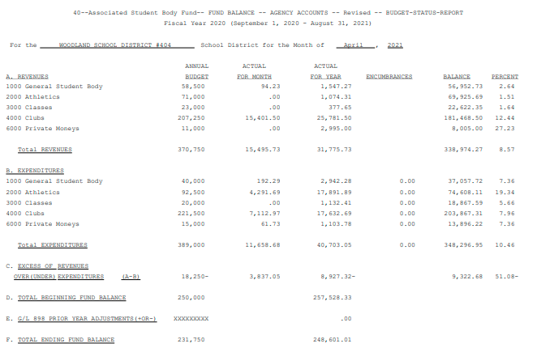
April 2021 Budget Status Report – ASB Fund

Slide 11
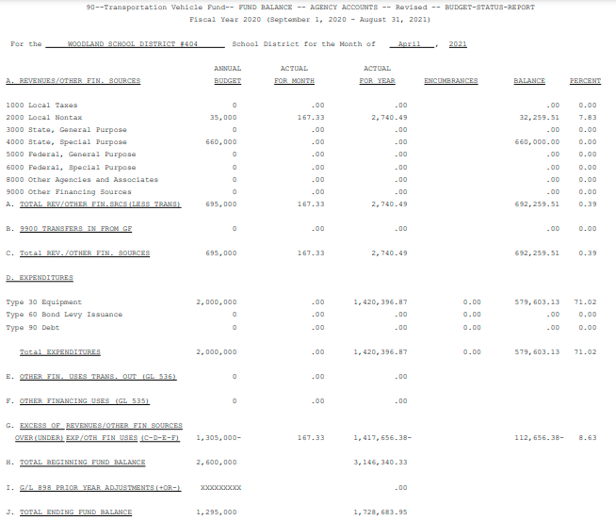
April 2021 Budget Status Report – Transportation Vehicle Fund

Slide 12
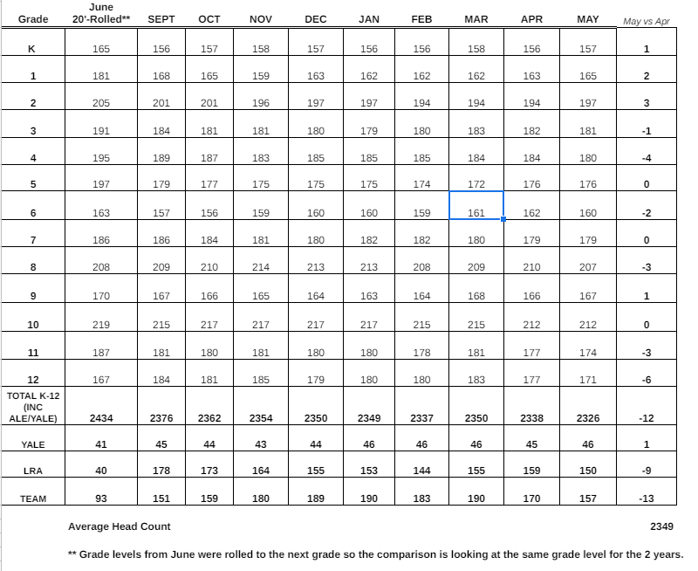
Enrollment Headcount – Thru May 2021

Slide 13
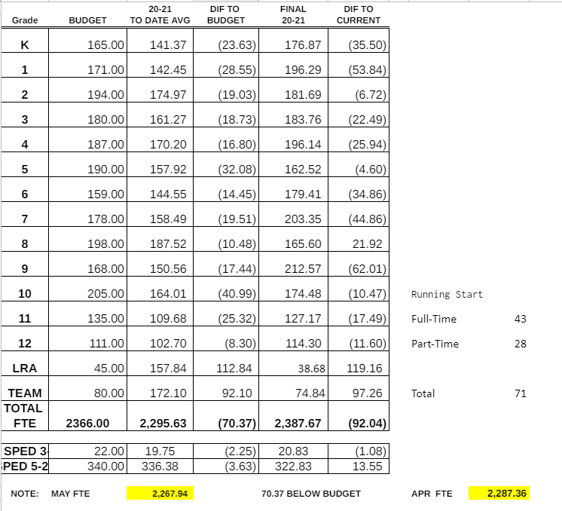
Enrollment Average FTE – Thru May 2021

